Slide 1
PRACTICAL (6 ) PATHOLOGY
Thyroid gland disorders

Slide 2
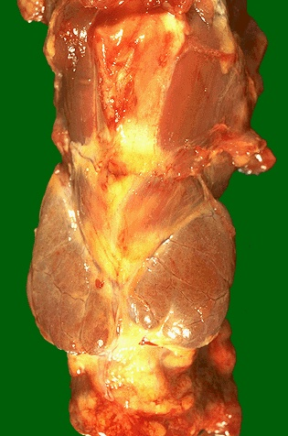
Macroscopic normal appearance of the thyroid gland in the middle of neck.

Slide 3
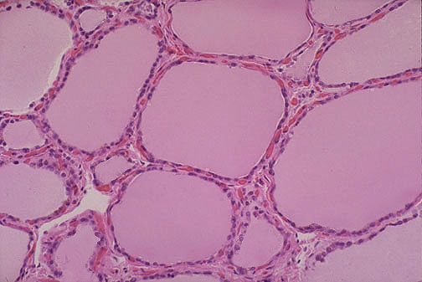
Microscopic normal thyroid consists of follicles lined
by a cuboidal epithelium and filled with pink, homogenous colloid

Slide 4
Graves Disease
Symmetrical enlargement of thyroid gland
Cut-surface is homogenous, soft and appear meaty
Hyperplasia and hypertrophy of follicular cells

Slide 5
Graves Disease

Slide 6
Hashimoto Thyroiditis
Diffuse enlargement
Firm or rubbery
Pale, yellow-tan, firm & somewhat nodular cut surface

Slide 7
Hashimoto Thyroiditis
Massive lymphoplasmcytic infiltration with lymphoid follicles formation
Destruction of thyroid follicles
Increased interstitial connective tissue

Slide 8
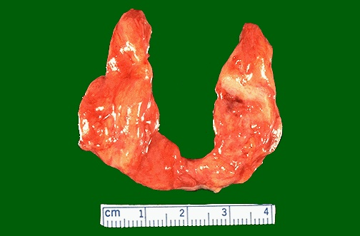
This symmetrically small thyroid gland demonstrates atrophy. This patient was hypothyroid. This is the end result of Hashimoto's thyroiditis.

Slide 9
Goiter goiter simply means enlarged thyroid

Slide 10
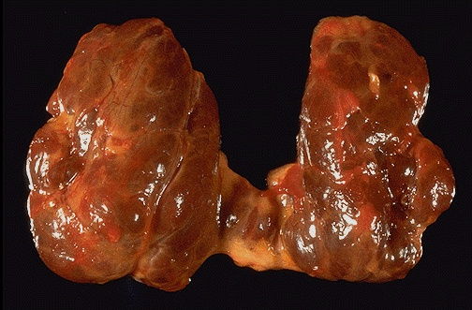
nodular goiter
This diffusely enlarged thyroid gland is somewhat nodular. .

Slide 11
Multinodular Goiter
Asymmetric enlargement
Multinodular
Haemorrhage
Calcification
Fibrosis
Cystic degeneration

Slide 12
Multinodular Goiter
Numerous follicles varying in size
Recent haemorrhage
Haemosiderin
Calcification
Cystic degeneration

Slide 13
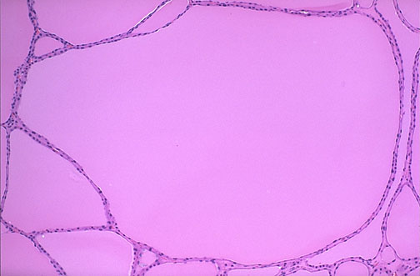
multinodular goiter.
The follicles are irregularly enlarged, with flattened epithelium, consistent with inactivity, in this microscopic appearance at low power of a multinodular goiter.

Slide 14
Thyroid Neoplasms
I. Primary Tumours
Epithelial
Malignant Lymphomas
Mesenchymal tumours
II. Metastatic Tumors

Slide 15
Epithelial Thyroid Neoplasms
Tumours of follicular cells
Benign (adenomas)
Follicular adenoma
Malignant (carcinomas)
Follicular carcinoma (10-20%)
Papillary carcinoma (75-85%)
Undifferentiated (anaplastic) carcinoma (<5%)
Tumours of C-cells
Medullary thyroid carcinoma (MTC - 5%)

Slide 16
Follicular Adenoma
Solitary, Variably sized, encapsulated, well-circumscribed with homogenous gray-white to red-brown cut-surface

Slide 17
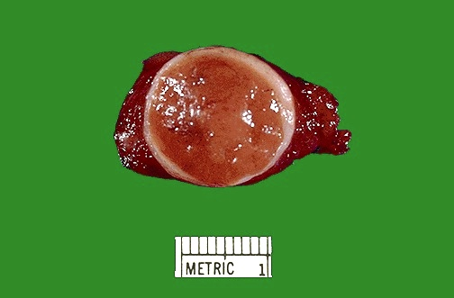
Here is another follicular neoplasm (a follicular adenoma histologically) that is surrounded by a thin white capsule. It is sometimes difficult to tell a well-differentiated follicular carcinoma from a follicular adenoma.

Slide 18
Follicular Carcinoma
Solitary round or oval nodule
Thick capsule
Composed of follicles
Capsular invasion or vascular invasion ,
minimally invasive and widely invasive

Slide 19
Papillary Carcinoma
Variable size (microscopic to several cm)
Solid or cystic
Infiltrative or encapsulated
Solitary or multicentric (20%)

Slide 20
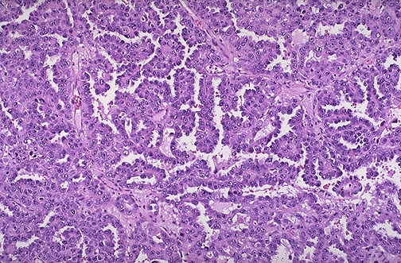
This is the microscopic appearance of a papillary carcinoma of the thyroid. The fronds of tissue have an overall papillary pattern. There is no such thing as a papillary adenoma, and all papillary neoplasms of the thyroid should be considered malignant.

